Slide 1
Database Connection

Slide 2
Agenda
Database Introduction
Database connection introduction
Examples

Slide 3
Database vs. DBMS
Database: A very large, integrated collection of data.
Models real-world enterprise.
Entities (e.g., students, courses)
Relationships (e.g., Madonna is taking CS186)
A Database Management System (DBMS) is a software package designed to store and manage databases.

Slide 4
Relational Database Model
Tables
Holds related entities or entity set
Also called relations
Comprised of rows and columns
Two-dimensional structure with rows and columns
Rows (tuples) represent single entity
Columns represent attributes
Tables must have an attribute to uniquely identify each row: a key

Slide 5
SQL – Structured Query Language
DDL (Data Definition Language) statements are used to build and modify the structure of your tables and other objects in the database.
DML (Data Manipulation Language) statements are used to work with the data in tables.

Slide 6
SQL - DDL
CREATE TABLE <table name>
( <attribute name 1> <data type 1>,
...
<attribute name n> <data type n>);
Create
Alter
Drop
ALTER TABLE <table name>
ADD CONSTRAINT <constraint name>
PRIMARY KEY (<attribute list>);
ALTER TABLE <table name>
ADD CONSTRAINT <constraint name> FOREIGN KEY (<attribute list>)
REFERENCES <parent table name> (<attribute list>);
DROP TABLE <table name>;
ALTER TABLE <table name>
DROP CONSTRAINT <constraint name>;

Slide 7
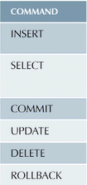
SQL - DML
INSERT INTO PRODUCT
VALUES (attribute 1 value, attribute 2 value, … etc.);
SELECT P_DESCRIPT, P_INDATE, V_CODE
FROM PRODUCT
WHERE V_CODE <> 21344;
COMMIT PRODUCT;
UPDATE PRODUCT SET P_SALECODE = ‘2’ WHERE P_CODE = ‘1546-QQ2’;

Slide 8
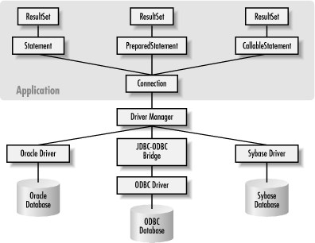
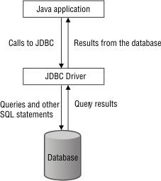
DB Connection – Driver Manager

Slide 9
MySQL
MySQL is one of DBMS
It is free when you use the community version
There are two options; web community (web-based) and community (desktop-based)
To install MySQL Workbench
http://dev.mysql.com/downloads/windows/installer/
Put the jar file in the lib of Tomcat Folder
Pay attention to the driver

Slide 10
DB Connection
For DB Connection, it is necessary to download a particular driver.
A particular driver depends on the DB type.
For example:
Oracle – ojdbc14.jar
MySQL - mysql-connector-java-x.x.xx-bin.jar
etc.

Slide 11
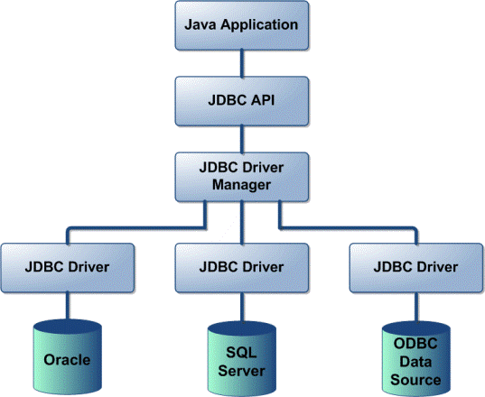
DB Connection
while (rs.next()) {
System.out.println(rs.getString(1));
}
DriverManager.getConnection(url, username, password);
Class.forName("com.mysql.jdbc.Driver");
ojdbc14.jar
mysql-connector-java-x.x.xx-bin.jar

Slide 12
DBconn.jsp
<%@ page import="java.sql.*" %>
<%@ page import="java.io.*" %>
<html>
<head>
<title>Connection with mysql database</title>
</head>
<body>
<h1>Connection status</h1>
<%
try {
String connectionURL = "jdbc:mysql://220.67.127.42:3306/"; //trial?autoReconnect=true&useSSL=false
String user = "jsp2016";
String pass = "jsp2016!";
Class.forName("com.mysql.jdbc.Driver").newInstance();
Connection connection = null;
connection = DriverManager.getConnection(connectionURL, user, pass);
if(!connection.isClosed()){
out.println("Successfully connected to " + "MySQL server using TCP/IP...");
Statement st = null;
String sql = "select * from trial.user";
out.println(sql);
st = connection.createStatement(); //ResultSet.TYPE_SCROLL_INSENSITIVE, ResultSet.CONCUR_READ_ONLY
ResultSet rs = st.executeQuery(sql);
%>
<table border=1>
<tr>
<th>ID</th>
<th>name</th>
<th>email</th>
<th>position</th>
</tr>
<%
while(rs.next())
{
String id = rs.getString("ID");
String name = rs.getString("Name");
String email = rs.getString("Email");
String position = rs.getString("Position");
%>
<tr>
<td><%=id %></td>
<td><%=name %></td>
<td><%=email %></td>
<td><%=position %></td>
</tr>
<%
}
%>
</table>
<%
}
connection.close();
}catch(Exception ex){
out.println("Unable to connect to database.");
}
%>
</font>
</body>
</html>

Slide 13
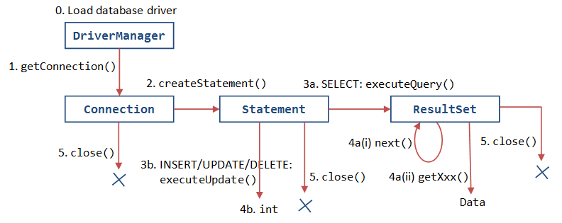
JDBC programming flow

Slide 14
DBconn.jsp
Server info
<%@ page import="java.sql.*" %>
<%@ page import="java.io.*" %>
<html>
<head>
<title>Connection with mysql database</title>
</head>
<body>
<h1>Connection status</h1>
<%
try {
String connectionURL = "jdbc:mysql://220.67.127.42:3306/"; //trial?autoReconnect=true&useSSL=false
String user = "jsp2016";
String pass = "jsp2016!";
Class.forName("com.mysql.jdbc.Driver").newInstance();
Connection connection = null;
connection = DriverManager.getConnection(connectionURL, user, pass);
if(!connection.isClosed()){
out.println("Successfully connected to " + "MySQL server using TCP/IP...");
Statement st = null;
String sql = "select * from trial.user";
out.println(sql);
st = connection.createStatement(); //ResultSet.TYPE_SCROLL_INSENSITIVE, ResultSet.CONCUR_READ_ONLY
ResultSet rs = st.executeQuery(sql);
%>
<table border=1>
<tr>
<th>ID</th>
<th>name</th>
<th>email</th>
<th>position</th>
</tr>
DriverManager
<%
while(rs.next())
{
String id = rs.getString("ID");
String name = rs.getString("Name");
String email = rs.getString("Email");
String position = rs.getString("Position");
%>
<tr>
<td><%=id %></td>
<td><%=name %></td>
<td><%=email %></td>
<td><%=position %></td>
</tr>
<%
}
%>
</table>
<%
}
connection.close();
}catch(Exception ex){
out.println("Unable to connect to database.");
}
%>
</font>
</body>
</html>
Connection
Statement
Close the connection
Resultset

Slide 15
DBconn.jsp
<%@ page contentType="text/html;charset=euc-kr"
import="java.sql.*,java.io.*" %>
<html>
<head>
<title>
JSP Connection
</title>
<meta http-equiv="Content-Type" content="text/html; charset=euc-kr">
</head>
<%
String url = "jdbc:mysql://203.253.70.34:3306/jsp2015";
String username = "user2015";
String password = "!user2015";
Connection conn = null;
try {
Class.forName("com.mysql.jdbc.Driver");
System.out.println("Connecting database...");
conn = DriverManager.getConnection(url, username, password);
System.out.println("Database connected!");
Statement stmt = conn.createStatement();
ResultSet rs =
stmt.executeQuery("select * from jsp2015.student");
while (rs.next()) {
System.out.println(rs.getString(1)+" "+rs.getString(2));
}
stmt.close();
conn.close();
} catch (SQLException e) {
throw new RuntimeException("Cannot connect the database!", e);
} finally {
System.out.println("Closing the connection.");
if (conn != null) try { conn.close(); } catch (SQLException ignore) {}
}
%>
<body>
Testing DB Connection
</body>
</html>
DriverManager
Connection
Statement
Resultset
Close the statement
Close the connection

Slide 16
How can we get the data using Table name?
We can use the resultSet and get function.
Note.
Method | Description
getString(int i) | To get a string value of a column at index i
getString(String s) | To get a string value of a column name s
getInt(int i) | To get an integer value of a column at index i
getInt(String s) | To get an integer value of a column name s
getDouble(int i) | To get a double value of a column at index i
getDouble(String s) | To get a double value value of a column name s
…

Slide 17
Finding Column Name
In some cases, you may not know the column name.
You need to find the detail description. Or, at least, you can know the name of column and number of column in a DB.
Next example is a java file.
It helps you to figure out the column name of a table STUDENT in the server.

Slide 18
getColumn.java
public static void main(String[] args) {
Connection conn = null;
Statement stmt = null;
ResultSet rs = null;
try {
conn = getConnection();
// prepare query
String query = "select * from student";
// create a statement
stmt = conn.createStatement();
// execute query and return result as a ResultSet
rs = stmt.executeQuery(query);
// get the column names from the ResultSet
getColumnNames(rs);
} catch (Exception e) {
e.printStackTrace();
System.exit(1);
} finally {
// release database resources
try {
rs.close();
stmt.close();
conn.close();
} catch (SQLException e) {
e.printStackTrace();
}
}
}
}
import java.sql.Connection;
import java.sql.DriverManager;
import java.sql.ResultSet;
import java.sql.ResultSetMetaData;
import java.sql.SQLException;
import java.sql.Statement;
public class getColumn {
public static Connection getConnection() throws Exception {
String url = "jdbc:mysql://203.253.70.34:3306/jsp2016";
String username = "user2016";
String password = "user2016!";
Class.forName("com.mysql.jdbc.Driver");
Connection conn = DriverManager.getConnection(url, username, password);
return conn;
}
public static void getColumnNames(ResultSet rs) throws SQLException {
if (rs == null) {
return;
}
ResultSetMetaData rsMetaData = rs.getMetaData();
int numberOfColumns = rsMetaData.getColumnCount();
// get the column names; column indexes start from 1
for (int i = 1; i < numberOfColumns + 1; i++) {
String columnName = rsMetaData.getColumnName(i);
// Get the name of the column's table name
String tableName = rsMetaData.getTableName(i);
System.out.println("column name=" + columnName + " table=" + tableName + "");
}
}

Slide 19
Next…
After you notice the column name of a table, you can retrieve the data by previous connection method.
Next is another example to connect to database of MySQL

Slide 20
DBConn2.jsp
<%@ page contentType="text/html;charset=euc-kr"
import="java.sql.*,java.io.*" %>
<html>
<head>
<title>
JSP Connection
</title>
<meta http-equiv="Content-Type" content="text/html; charset=euc-kr">
</head>
<body>
<%
String url = "jdbc:mysql://203.253.70.34:3306/jsp2016";
String username = "user2016";
String password = "user2016!";
Connection conn = null;
try {
Class.forName("com.mysql.jdbc.Driver");
System.out.println("Connecting database...");
conn = DriverManager.getConnection(url, username, password);
System.out.println("Database connected!");
Statement stmt = conn.createStatement();
ResultSet rs =
stmt.executeQuery("select * from jsp2016.student");
%>
<table border="1">
<tr>
<th>Student ID</th>
<th>Student Name</th>
</tr>
<%
while (rs.next()) {
System.out.println(rs.getString(1)+" "+rs.getString(2));
%>
<tr>
<td>
<p align="center">
<font size="3"><%=rs.getString("studentID")%></font>
</td>
<td>
<p align="center">
<font size="3"><%=rs.getString("studentName")%></font>
</td>
</tr>
<%
}
stmt.close();
conn.close();
} catch (SQLException e) {
throw new RuntimeException("Cannot connect the database!", e);
} finally {
System.out.println("Closing the connection.");
if (conn != null) try { conn.close(); } catch (SQLException ignore) {}
}
%>
</table>
</body>
</html>

Slide 21
Summary
DB connection (using MySQL)
DB schema in java file

